Slide 1
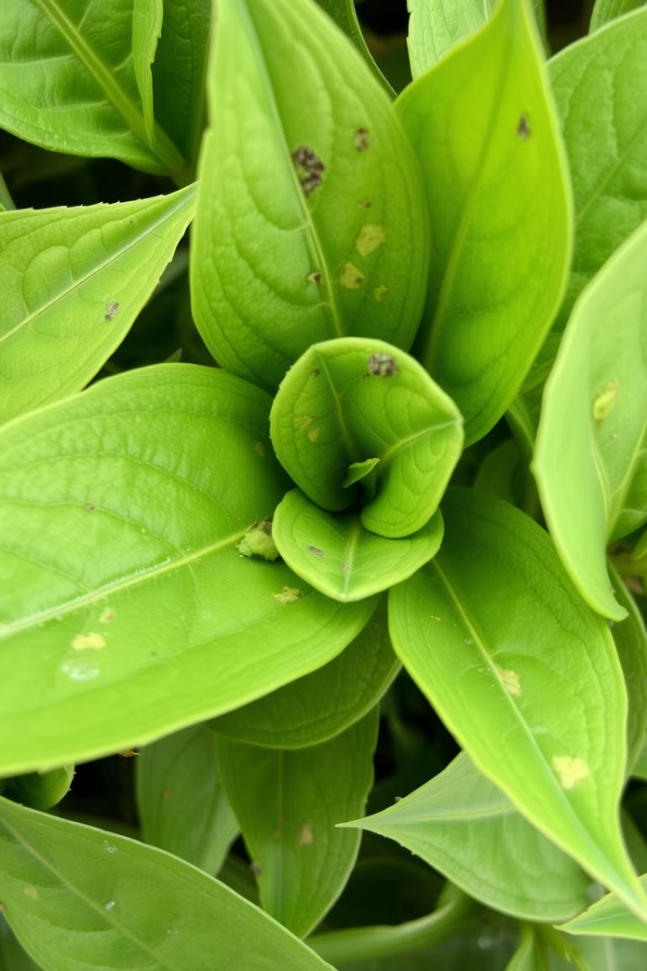
Plant Disease Detection
Identifying and managing plant diseases is crucial for maintaining healthy crops and gardens. This presentation will provide an overview of common plant diseases, their symptoms, and techniques for early detection using advanced technology.

Slide 2
Meet the Team
NAGANNA DORA SASTRY
SAI KRISHNA
BHARGAV
KARTHIKEYA
S20220020273
S20220020313
S20220020252
S20220020298

Slide 3
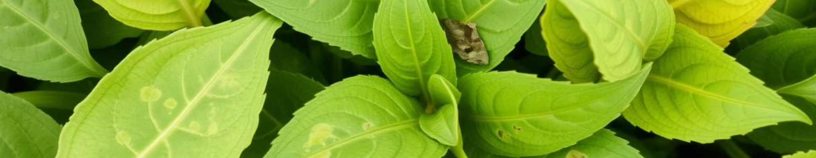
Introduction to Plant Diseases
1
Causes
2
Impact
3
Early Detection
Plant diseases can be caused by fungi, bacteria, viruses, or environmental stress.
Diseases can lead to reduced yields, quality issues, and even complete crop failure.
Timely identification is key to implementing effective management strategies.

Slide 4
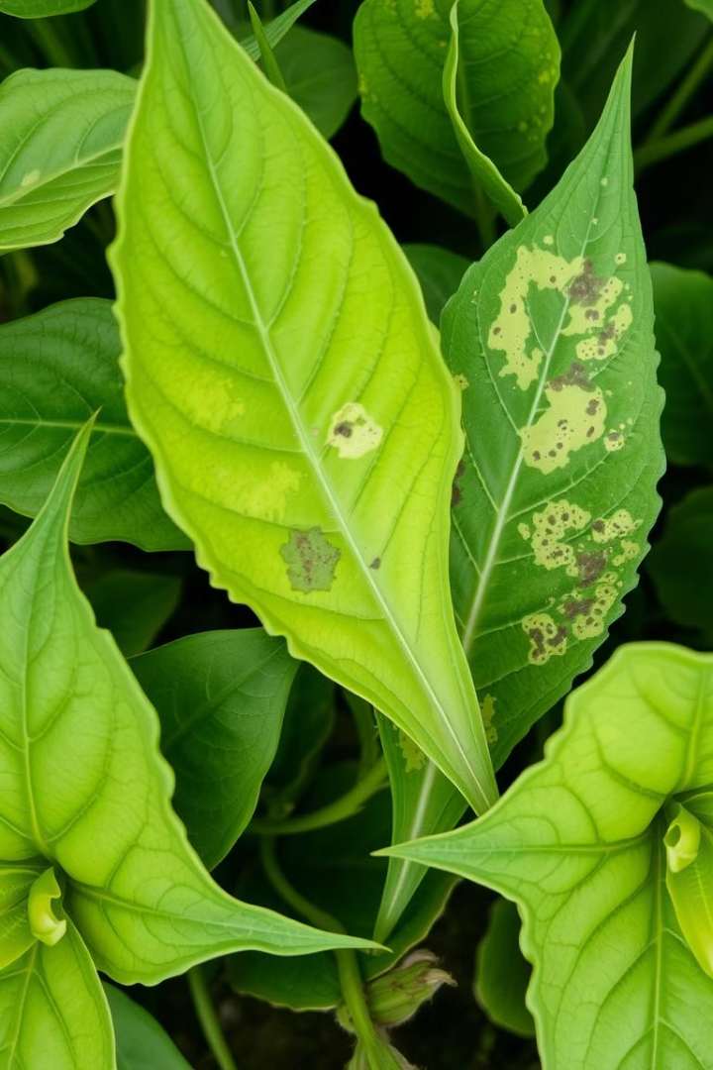
Common Plant Diseases and Symptoms
Powdery Mildew
Leaf Spot
White, powdery growth on leaves and stems.
Circular or irregular spots on leaves, often with a distinctive color.
Rust
Wilt
Orange, red, or brown pustules on leaves and stems.
Drooping, wilting, and yellowing of leaves.

Slide 5
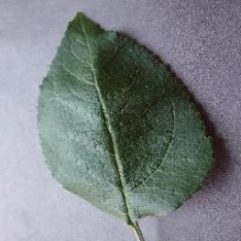
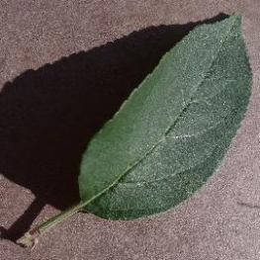
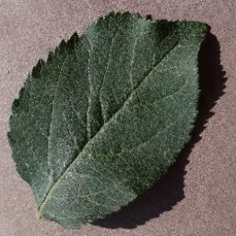
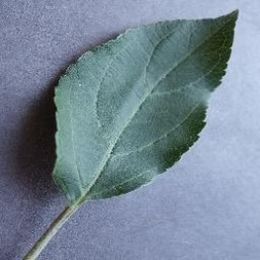
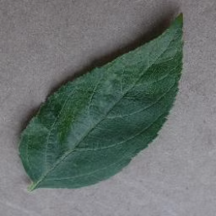
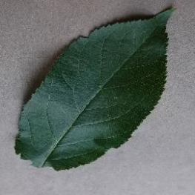
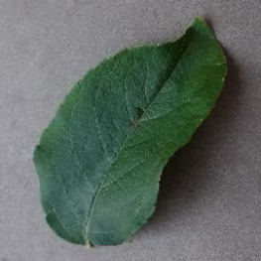
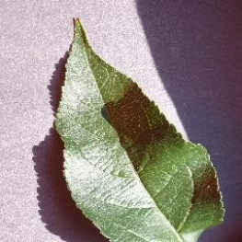
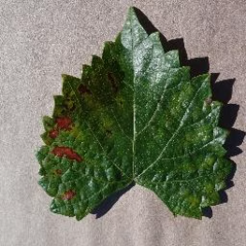
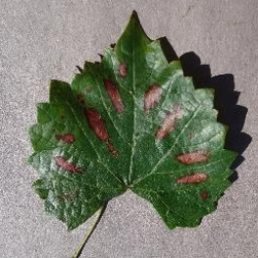
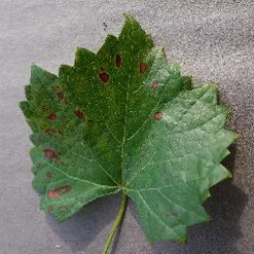
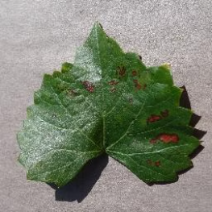
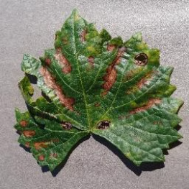
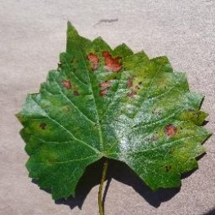
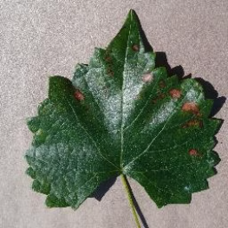
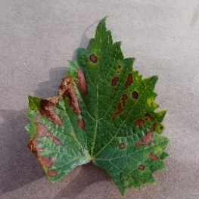
INPUT DATA SAMPLES

Slide 6
CLASSIFICATION MODELS
1. K-Nearest Neighbors (KNN)
KNN predicts a class based on the majority label of its k nearest neighbors in the feature space. It’s simple, effective for small datasets, and sensitive to the choice of k. However, it can be computationally expensive for large datasets.
2. Decision Tree
This model splits data into decision rules using a tree structure, where leaf nodes represent classes. It’s easy to interpret and handles non-linear decision boundaries but is prone to overfitting. Proper tuning (e.g., limiting tree depth) can improve performance.
3. Random Forest
An ensemble of decision trees, Random Forest uses bagging to improve diversity and reduce overfitting. It’s robust, handles high-dimensional data well, but can be slower and less interpretable.
4. Logistic Regression (Multiclass)
A linear model that predicts class probabilities using logistic functions. For multiclass problems, a "one-vs-all" approach is used. It’s efficient for linearly separable data but struggles with non-linear decision boundaries.
5. Gaussian Naive Bayes (Gaussian NB)
Gaussian NB is a probabilistic classifier based on Bayes' Theorem, assuming features follow a Gaussian (normal) distribution. It is simple, fast, and effective for high-dimensional datasets but relies on the assumption of feature independence. It performs well for linearly separable problems but struggles with complex feature relationships.

Slide 7
Clustering Techniques
K-Means Clustering: A partition-based clustering method that groups data points into 'k' clusters by minimizing the within-cluster variance. It is fast and works well for spherical and evenly-sized clusters but requires 'k' to be predefined and is sensitive to outliers.
DBSCAN (Density-Based Spatial Clustering of Applications with Noise): A density-based clustering technique that groups points closely packed together, marking sparse regions as noise. It can detect clusters of arbitrary shape and handle outliers but may struggle with datasets of varying densities.

Slide 8
Classification Metrics
Model
Accuracy
Precision
Recall
F1-Score
KNN
0.8499
0.7878
0.7905
0.7818
Decision Tree
0.7048
0.6301
0.6246
0.6271
Random Forest
0.6919
0.6620
0.5667
0.5821
Logistic Regression
0.6059
0.6009
0.5073
0.4971
Clustering Metrics
Clustering Model
Adjusted Rand Index (ARI)
K-Means
0.1785
DBSCAN
0.0013

Slide 9
Team Contribution
Karthikeya
Task: Data Collection and Preprocessing
Karthikeya Task: Data Collection and Preprocessing
Karthikeya played a crucial role in ensuring the dataset was ready for analysis and feature extraction. He gathered images from the dataset and meticulously preprocessed them. His work included extracting RGB histograms to capture color distribution and Local Binary Patterns (LBP) to capture texture information from each image. Both types of features were then normalized to ensure uniform scaling, which is essential for effective model training and evaluation.
Additionally, Karthikeya ensured that the dataset was organized and formatted correctly to streamline its use in machine learning workflows. This involved verifying data integrity, handling any missing or corrupted entries, and labeling the dataset appropriately. His efforts provided a clean, standardized dataset that served as the foundation for subsequent feature extraction, model training, and clustering.
Naganna
Task: Model Training and Evaluation Naganna Task: Feature Extraction, Code Implementation, and Model Training
Naganna was responsible for implementing and training multiple classification models, including KNN, Decision Trees, Random Forest, Logistic Regression, and Naive Bayes. His work started with feature extraction, where he used both color histograms and LBP features generated during preprocessing to create input data for the classifiers.
He also ensured the project was accessible and user-friendly by writing modular code with well-defined paths. Naganna designed the codebase so that it could run seamlessly on any system, regardless of setup, by using a universal directory structure (./foldername). This portability enabled easy replication and testing of the project on multiple devices.
After implementing the models, Naganna evaluated their performance using metrics such as accuracy, precision, recall, and F1-score, comparing the strengths and weaknesses of each classifier.

Slide 10
Sai Krishna
Task: Clustering Algorithms Sai Krishna Task: Clustering Algorithms and Code Implementation Sai Krishna was in charge of implementing clustering algorithms, focusing on K-means and DBSCAN. He applied similar logic as Naganna for coding, ensuring that the clustering scripts were modular and portable. By setting up paths with a ./foldername structure, Sai Krishna made sure the clustering code could be executed seamlessly on any laptop without requiring reconfiguration.
To evaluate clustering quality, Sai Krishna used metrics like the Adjusted Rand Index (ARI), ensuring a thorough assessment of the models' ability to group data effectively. His work contributed to understanding the structure and patterns within the dataset, complementing the classification models.
Bhargav
Task: Visualization and Reporting Bhargav played a critical role in visualizing the project’s results and ensuring they were communicated effectively. He designed detailed graphs and plots, including precision-recall curves, bar charts, and confusion matrices, to highlight model performance metrics like accuracy, precision, and recall. His focus was not just on accuracy but also on making these visualizations intuitive and engaging for both technical and non-technical audiences. By incorporating clear annotations and structured layouts, Bhargav ensured that the insights from the analysis were accessible and actionable.
In addition to visualization, Bhargav collaborated closely with Sai Krishna to prepare the final report and presentation. They worked together to create a cohesive narrative, ensuring the document flowed logically from problem statement to conclusions. The presentation was crafted with an emphasis on clarity, professionalism, and visual appeal, using concise points and engaging visuals to captivate the audience. Bhargav’s efforts in visualization and documentation were instrumental in effectively conveying the project’s key findings and outcomes.
Regular team gatherings have been organized to facilitate in-depth discussions on our project's advancements, tackle any challenges encountered, and explore opportunities for potential improvements.

Slide 11
Conclusion
In this project, we implemented and evaluated multiple machine learning models for image-based classification using the PlantVillage dataset. Key models like K-Nearest Neighbors, Decision Trees, Random Forests, Logistic Regression, and Naive Bayes were employed, demonstrating varying performance in terms of accuracy and precision. Clustering techniques such as K-Means and DBSCAN were also explored for unsupervised learning. Among the methods, K-Nearest Neighbors showed the best results, achieving high accuracy and F1-scores.
Additionally, feature extraction techniques such as color histograms and Local Binary Patterns (LBP) were analyzed for their impact on model performance. The color histogram approach yielded an accuracy of 85% with K-Nearest Neighbors, significantly outperforming the LBP approach, which achieved 52% accuracy with the same classifier. This result emphasizes the importance of selecting appropriate feature extraction techniques tailored to the dataset and classification task.
Overall, the project highlights the crucial role of feature extraction and data preprocessing in achieving reliable outcomes. This comprehensive approach provides insights into the strengths and limitations of various algorithms and techniques for agricultural disease detection tasks.

Slide 12
THANK YOU

